Slide 2
A Crash Course in RAMP Overview, Navigation, and Common Issues
Shelly Earl
Divina Allan
Timia Joseph

Slide 3
Overview

Slide 4

Who are we?
The three of us comprise the RSP ERA Squad.
We are Grants System Business Analysts and we provide support to the several systems used for research administration, including RAMP

Slide 5
RAMP Overview
The Research Administration Management Portal, RAMP, is UW’s instance of the Huron Research Suite
RAMP is the main pre-award system used to document proposal development, submission, and award acceptance
RAMP has 3 modules:
  Agreements
  Grants (SF424)
  Export Control – not covered in this presentation

Slide 6
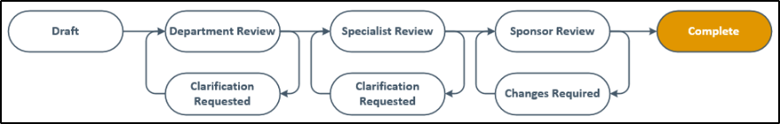
High-level Workflow
After funding opportunties are identified, proposal development begins.
Department resarch admins generally create a funding proposal in RAMP to start consolidating proposal documentation and obtaining approvals

Slide 7
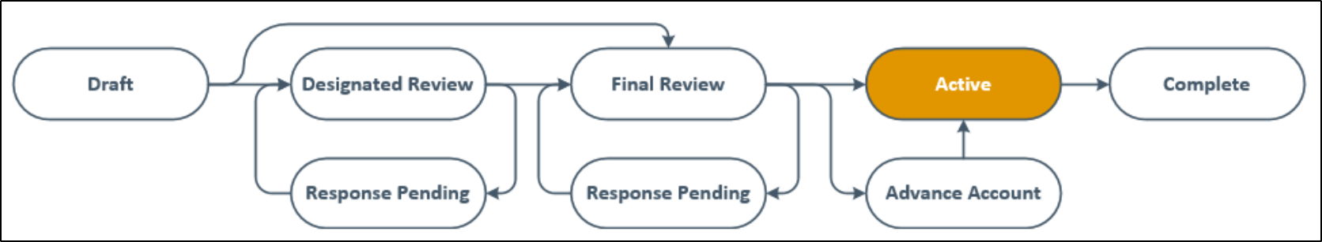
High-level Workflow
After sponsor review, if the proposal is awarded, it is time for agreements and awards.
RSP will create award records and then work with divisions and departments to complete configuration.
RSP activates awards which is what sends them to SFS

Slide 8
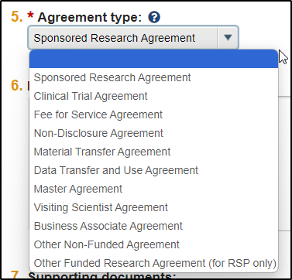
Agreements - https://ramp.wisc.edu/Agreements/
The Agreements module is your one stop shop for all negotiated agreements

Slide 9
Grants - https://ramp.wisc.edu/Grants/
Funding Proposals (FP)
Awards (AWD)
Award Modification Request (AMR)
Budgets (BU)
SF424 (SF-424)
Award Modification (suffix MOD)
Complex Proposals (MPP)
Revisions (suffix REV)
Continuations (suffix CON)
Resubmission (suffix RES)
Renewals (new FP)

Slide 10
Navigating Like a Pro

Slide 11
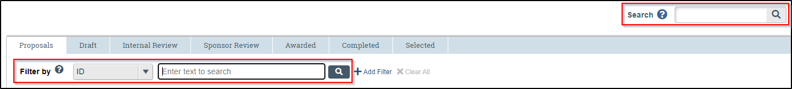
Navigating Like a Pro – Search Boxes
Filter by vs. Search
RAMP is a series of list reports. Use filter by to find discrete records on the list you're looking at.
Use the search box to search more generally across each module.
  NOTE: You cannot search for agreements in the grants module and vise versa!

Slide 12
Navigating Like a Pro – Filtering
% as a wildcard—your filtering best friend!
Logic operators are available, just add a dash:
  -and
  -or
Want to exclude? Use != to say what you do NOT want
Dates can use our good ol’ alligators to define a range:
  EX: >9/1/2023 -and <1/1/2024 translates to dates after 9/1/2023 and before 1/1/2024

Slide 13
Reporting Demo
Grants
Reports
Custom Reports

Slide 14
Common Questions & Issues

Slide 15
Access - Overview
Users come from HRS, which is pulled into SFS, which then sends to RAMP
Types of access
  Record-level: Access to a specific record via Manage Access activity
    Admin contact, read-only rights or edit rights
    Able to move record through workflow (submit to RSP, submit for dept approval, etc.)
  Department admin editor: Access to all records in a given department
    Can edit the SmartForm whenever the record is in editable state
    Does not always have same activities available as record-level editors; may need to be added to take workflow steps
  Division member: Access to all records in a division
    Approve funding proposals, Manage Access, and more
Notes:
-Where do users come from? All user accounts start in the HR system, or HRS; HRS drives whether an account is active or not. Every UW employee will have an account by the start date of their appointment. Sponsors also come from this feed, which is why it is necessary to wait overnight after a new sponsor is added in RAMP.
-There are many different types of access in RAMP. Here is a quick breakdown of those you will interact with most:
--Record-level grants access to a particular record. This access is managed with the Manage Access activity or directly in the SmartForm where you enter personnel. Folks in your dean's office and anyone who is a department admin editor can use the Manage Access activity. Those with record-level access can use activities that move a record through workflow, like submitting to RSP or to the department and so on. PIs have this access​
--Department admin editors are set per department, and they can see all records in that given department. Admin editors are able to edit the SmartForm for any records in this department as long as they are in an editable state; this does not grant the ability to edit the SmartForm while a record is in Specialist Review, for example, or other states in which the department typically can't edit. The admin editor does not automatically get the exact same access record-level editors, meaning they sometimes can't submit a record if they are not specified as an editor on the record.
--Your dean's office has division member access, which allows them to see all records in their division. They are able to review and approve funding proposals, use Manage Access, and typically receive any ancillary reviews sent to a division instead of a department.

Slide 16
Access Issues
Contact your dean's office when:
  You need access to a record
  A new RA needs departmental access granted or updated
  A change is needed to notification recipients (especially emails from SFS)
    WISPER lists still used for SFS emails
When you can't find a user, contact era@rsp.wisc.edu
Notes:
-When you are looking to gain access or give someone else access to something in RAMP, your first point of contact is your dean's office. They are able to grant you access to any record within the division. They also approve access requests to gain additional roles or be added as an admin editor or ancillary reviewer to any departments; if you reach out to us first, we will still have to reach out to them and wait for their confirmation, so it is best to just contact them to begin with so they can determine what access you need to accomplish your duties, then move from there. They also have access to a report that shows all admin editors and ancillary reviewers for their departments, so they can verify who has elevated department access at any given time. If you were here prior to us going live with RAMP, you'll remember that in WISPER, there were department lists that your dean's office managed, and these lists determined email recipients to various award/proposal-related emails from SFS. These lists are still in use, so the process to add or remove recipients is the same: contact your dean's office.
-We talked about how users come from HRS and pull through SFS to RAMP; sometimes, a timing issue may cause a breakdown in that chain and cause a user to not appear in the system. When that happens, please reach out to us so we can look into it.

Slide 17
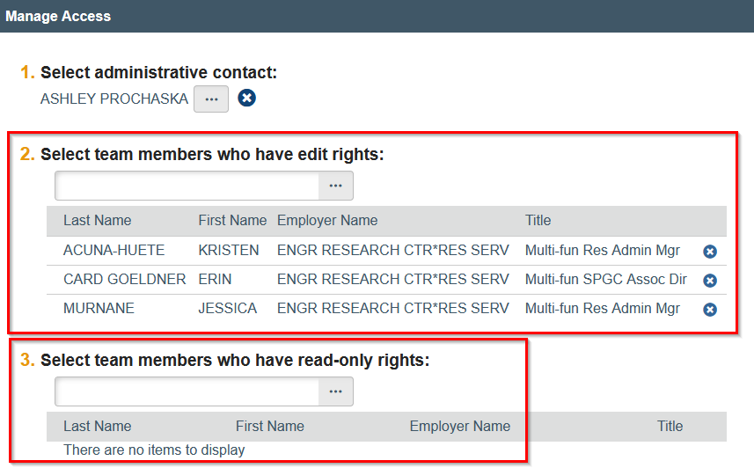
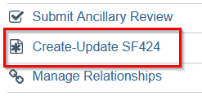
SF424 Access
Why can't I access the SF424?
  By default, funding proposal creator and funding proposal editors/readers have access
  Verify appropriate people have edit/read access to funding proposal before creating the SF424
  Fix: Re-run the Create-Update SF424 activity
    If you've started editing the SF424 already, uncheck forms so they don't get overwritten
Notes:
-Speaking of access issues, a lot of folks have run into issues with not being able to access the SF424, whether they are an editor on the FP or have just created it.
--The person who created the funding proposal and anyone listed as an editor or reader on the SF424 have access to it. If you somehow fit neither of those criteria but created the SF424 itself, you may still not have access to it.
--To minimize issues, double-check that everyone who needs access to the SF424 has access to the FP before creating it.
--Sometimes, however, an error occurs during the process of creating the SF424 that causes FP access to not get carried over. Then, even if everyone is correctly listed as an editor or reader, they still won't have access.
--In either case, the fix is the same: you must run Create-Update SF424 activity again once everyone has the proper access to the FP
---If you have gone into the SF424 and started entering data and making changes, uncheck those forms so the activity doesn't overwrite your work. Even if you have no forms selected, the activity will re-run the script that copies FP access over, so it will still work

Slide 18

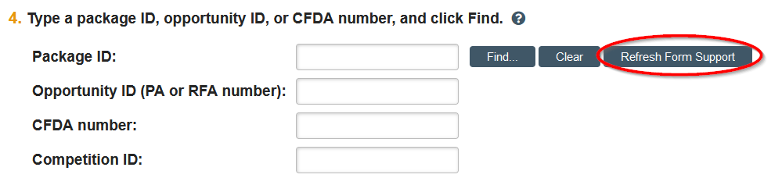

Other SF424 Issues
All the forms say "Yes" under Supported, but getting this error?
On Submission Information page, click Refresh Form Support
If Create-Update SF424 activity is missing, double-check question 3 is "Yes"
  If it was "No", may need to click Refresh Form Support to get forms to validate that they're supported
RSP proposals team has ability to update SF424 status
Notes:
-Have you ever been confused to see this error? "Some of the required forms are not supported," but you look at the column and all of the forms say they ARE supported? Easy fix—click Refresh Form Support. It does what it says, and it should remove the error once the system catches up on the forms actually being supported.
-Same solution if you had to update question 3, "Will this be submitted S2S?" If Create-Update SF424 activity is missing, this is one of the common causes we see. So double-check that this is "yes", and then you may need to run "Refresh Form Support" if you have issues with the forms after entering FOA
-As far as the status received back from Grants.gov on the SF424, there is a nightly job that runs to update the statuses of all applications, but if you know there has been an update today, the proposals team has access to an activity that will have RAMP check again for any status updates

Slide 19
ARROW
Integration runs twice a day – 6:00 AM and 12:30 PM
  If you made changes in between then, wait until next run and then check again if not seeing something you're expecting
RAMP records MUST be listed as a primary funding source in ARROW protocols
Support
  For help with issues in ARROW, contact irb-arrow@research.wisc.edu
  Job aid: How to Answer Compliance Questions & Associate ARROW Protocols
  Video: RAMP - Compliance Questions and Arrow Integration
Notes:
-There is a job that runs to facilitate communication between RAMP and ARROW that runs twice a day. If you have entered your protocol in ARROW or created a RAMP record in between those two times, wait for the next run and see if the protocol/record shows up in RAMP/ARROW
-There are a lot of instances of folks listing RAMP records as "other funding" within ARROW. In order for the protocol to show up in RAMP, it MUST be listed as primary funding in ARROW. This is also called out in the job aid we have for this.
-If you are having problems with not seeing an integration in RAMP, please reach out to us. For help with ARROW, ERA has limited knowledge on that system and it is best to loop in the IRB team that supports ARROW to assist with those questions.
-We have linked out to all resources for this workflow here; the job aid has a direct link to the IRB page with more detailed information on using ARROW.

Slide 20
Follow-ons (Continuations, Resubmissions, Renewals, and Revisions)
Overview
  Continuations: used for progress reports and continuation proposals (ex. NIH RPPRs)
  Resubmissions: unfunded application that has been modified and is to be resubmitted
  Renewals: request additional funding for a period subsequent to current award period
  Revisions: request for additional funds during current project period to support new/additional activities not identified in current award
Can have multiple: Renewals and Revisions
Only one active at a time: Continuations and Resubmissions
Notes:
-We also wanted to do a quick review of how follow-ons work since this also comes up a lot. On the slide is a summary of what each type is for/does, but this information is also a RAMP Tip of the Week that was sent out (and can be accessed now from the RAMP FAQ page)
-Continuations – used for progress reports requiring RSP submission and continuation proposals that require authorized official or RSP involvement/signatures
-Resubs
-Renewals
-Revisions
-Different types of follow-ons have different limitations on how many of these you can have open at a time. This was determined by Huron, the vendor, and is not something we can change. You may have tried to create one of these and discovered that you cannot, and see a message that says "Follow-on in progress"
-You can have more than one renewal or revision active at once
-You may only have ONE continuation or ONE resubmission active at a time. If you feel you need another one of these records, you will need to evaluate whether you can continue using the existing one, or if it should be withdrawn so you can create a new one.

Slide 21
Other Tips
If you need a new sponsor added, please fill out this form: https://rsp.wisc.edu/sfs/addSponsorInfo/
When reaching out to ERA, please include screenshots—we love screenshots!
ERA does not set up eRA Commons IDs—please contact your dean's office
Reference available resources:
  RAMP Resources page – videos, job aids, user guides
  RAMP FAQ – includes RAMP Tips of the Week
  Contact RSP
    Overall pre-award team - preaward@rsp.wisc.edu
    Proposals – ramp-proposals@rsp.wisc.edu
    Awards Setup – award@rsp.wisc.edu
Notes:
-If you can't find the sponsor you're looking for and want to request to have one added, please fill out the linked form on the RSP website. ERA does not handle those requests. You will get an email notifying you when the sponsor has been added in SFS, and you should be able to see it in RAMP the next day.
-When you reach out to us for help resolving an issue, it would really help us if we could see what you're seeing. Please include screenshots in your email whenever possible, we love them!
-Despite sharing an acronym, we cannot help you with setting up an eRA Commons ID or account. Please reach out to your dean's office and they can help get you started
-There is a lot of good information on the RAMP Resources page; even I still go out there to look things up when I can't remember how to do something or how something works. If you are a visual learner, there are videos in addition to the user guides and the job aids.
--Treat job aids as quick bites to get you information to a specific task you are trying to do
--Treat user guides as a sort of "great big book of everything," as it compiles all of the information in the job aids and in some cases has more detailed info since the job aids are written to be concise
-The RAMP FAQ lists some of the more common questions we get in our inbox, so in addition to the RAMP Resources page, this is a great resource for when you have questions as well
--There is a box you can tick to show RAMP Tips of the Week—no need to dig through your emails!
-Finally, we've listed

